Slide 1
Conditional Expressions and Subqueries Dr Mariana Rocha School of Computer Science
CPMU 2007 Databases 1, Lecture 8

Slide 2
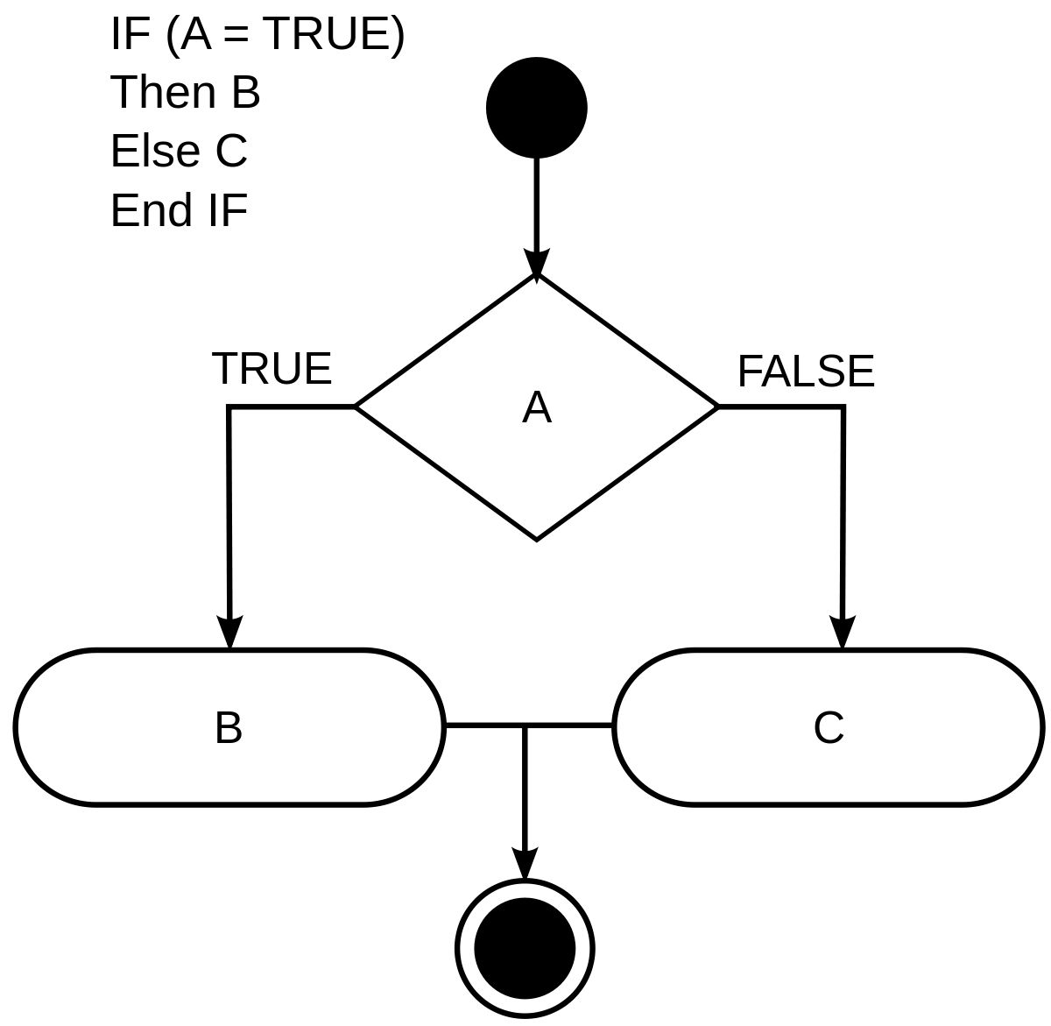
Conditional Expressions
Provide the use of IF-THEN-ELSE logic within a SQL statement

Slide 3
CASE expression
The CASE expression goes through a list of conditions, returning a value once a condition is met (like an if-then-else statement).
If a true condition is met, the query stops reading the data and return the result.
If no conditions are true, it returns the value in the ELSE clause.
If there is no ELSE part and no conditions are true, it returns NULL.
--syntax
SELECT attribute,
CASE
WHEN condition1 THEN result1
WHEN condition2 THEN result2
WHEN conditionN THEN resultN
ELSE result
END
FROM tablename;

Slide 4
CASE expression
PostgreSQL lets you use CASE almost anywhere:
SELECT list
WHERE clause
ORDER BY clause

Slide 5
Simple CASE
SELECT
p.player_name,
pa.position,
CASE pa.position
WHEN 'GK' THEN 'Goalkeeper'
WHEN 'CB' THEN 'Defender'
WHEN 'RB' THEN 'Defender'
WHEN 'LB' THEN 'Defender'
WHEN 'CM' THEN 'Midfielder'
WHEN 'CDM' THEN 'Midfielder'
WHEN 'CAM' THEN 'Attacker'
WHEN 'LW' THEN 'Attacker'
WHEN 'RW' THEN 'Attacker'
WHEN 'ST' THEN 'Attacker'
ELSE 'Other / Utility'
END "Position category"
FROM players p
JOIN player_attributes pa USING (player_id)
LIMIT 15;
A simple CASE compares one column to a fixed set of values.
It’s often used to translate coded attributes (such as positions or rating levels) into clearer categories.

Slide 6
Searched CASE
SELECT
pc.player_id,
p.player_name,
pc.wage,
CASE
WHEN pc.wage >= 50000 THEN 'Tier 1: Elite'
WHEN pc.wage >= 10000 THEN 'Tier 2: First Team'
WHEN pc.wage >= 2000 THEN 'Tier 3: Rotation'
WHEN pc.wage IS NULL THEN 'No contract / unknown'
ELSE 'Tier 4: Youth / Low cost'
END "Salary band"
FROM player_contracts pc
JOIN players p USING (player_id);
A searched CASE is more flexible.
It can use different conditions for each WHEN clause.
It will evaluate a set of Boolean expressions (TRUE or FALSE) and return the result for the first TRUE condition

Slide 7
CASE and WHERE
The CASE statement in the WHERE clause is evaluated for each row, and it returns a value based on the conditions.
The returned value can be used to apply different WHERE conditions based on the result.

Slide 8
CASE and WHERE
Suppose you want retrieve players following specific conditions about their wage.
For big clubs (like Real Madrid or Chelsea), you only want players earning more than 50,000/week.
For smaller clubs, you want players earning more than 5,000/week.
You can write that conditional logic using CASE inside the WHERE clause.

Slide 9
CASE and WHERE
SELECT
p.player_name,
c.club_name,
pc.wage
FROM players p
JOIN player_contracts pc USING (player_id)
JOIN clubs c USING (club_id)
WHERE
pc.wage >
CASE
WHEN c.club_name IN ('Real Madrid', 'Chelsea') THEN 50000
ELSE 5000
END
ORDER BY c.club_name, pc.wage DESC;

Slide 10
CASE and Maths operations
We can also use the CASE expression combined with mathematics operations to modify the value shown in the output.
Suppose we want to simulate an updated wage budget for next season:
Increase wages by 10% for players earning less than €10,000/week.
Increase wages by 5% for players earning between €10,000 and €50,000/week.
No increase for players above €50,000/week.

Slide 11
CASE and Maths operations
SELECT
p.player_name,
c.club_name,
pc.wage,
CASE
WHEN pc.wage < 10000 THEN pc.wage * 1.10
WHEN pc.wage BETWEEN 10000 AND 50000 THEN pc.wage * 1.05
ELSE pc.wage
END "Projected wage"
FROM players p
JOIN player_contracts pc USING (player_id)
JOIN clubs c USING (club_id)
WHERE pc.wage IS NOT NULL
ORDER BY c.club_name, pc.wage DESC;

Slide 12
CASE and SQL functions
You’re preparing a financial report that groups clubs into “High Budget”, “Medium Budget”, or “Low Budget” tiers based on their average player wage.
SELECT
c.club_name,
ROUND(AVG(pc.wage)) "Average wage",
CASE
WHEN AVG(pc.wage) >= 40000 THEN 'High Budget Club'
WHEN AVG(pc.wage) BETWEEN 10000 AND 39999 THEN 'Medium Budget Club'
WHEN AVG(pc.wage) < 10000 THEN 'Low Budget Club'
ELSE 'No Data'
END "Budget category"
FROM clubs c
JOIN player_contracts pc USING (club_id)
WHERE pc.wage IS NOT NULL
GROUP BY c.club_name
ORDER BY AVG(pc.wage) DESC;

Slide 13
CASE and LIKE
We can also establish the case expression considering string values by combining it with the LIKE operator:
SELECT
p.player_name,
CASE
WHEN p.player_name LIKE '%Junior%' THEN 'Brazilian-style name'
WHEN p.player_name LIKE '%inho' THEN 'Brazilian-style name'
ELSE 'Other pattern'
END AS name_pattern
FROM players p
ORDER BY 2 ASC;

Slide 14
CASE and LIKE
We can also establish the case expression considering string values by combining it with the LIKE operator:
SELECT
p.player_name,
CASE
WHEN p.player_name LIKE '%Junior%' THEN 'Brazilian-style name'
WHEN p.player_name LIKE '%inho' THEN 'Brazilian-style name'
ELSE 'Other pattern'
END AS name_pattern
FROM players p
ORDER BY 2 ASC;

Slide 15
CASE in ORDER BY
Suppose we want to list all players, but sort them by their playing role priority instead of alphabetically. For instance:
Attackers first
Then Midfielders
Then Defenders
Finally Goalkeepers

Slide 16
CASE in ORDER BY
SELECT
p.player_name,
pa.position,
pa.overall
FROM players p
JOIN player_attributes pa USING (player_id)
ORDER BY
CASE
WHEN pa.position IN ('ST', 'LW', 'RW', 'CAM') THEN 1 -- Attackers
WHEN pa.position IN ('CM', 'CDM', 'LM', 'RM') THEN 2 -- Midfielders
WHEN pa.position IN ('CB', 'LB', 'RB', 'RWB', 'LWB') THEN 3 -- Defenders
WHEN pa.position = 'GK' THEN 4 -- Goalkeepers
ELSE 5 -- Unknown / other
END;

Slide 17
Subquery in SQL
A subquery is a query nested inside a bigger query
The subquery can be nested inside a SELECT, INSERT, UPDATE, or DELETE statement, or inside another subquery

Slide 18
Subquery in WHERE clause
2)
SELECT attribute_name FROM table_name WHERE condition (SELECT attribute FROM table_name WHERE condition);
1)
1) The subquery (inner query) executes once before the main query (outer query).
2) The result of the subquery is used by the main query.

Slide 19
Single-row subqueries
Return only one row from the sub-query
Use single-row comparison operators
Operator | Meaning
= | Equal to
> | Greater than
>= | Greater than or equal to
< | Less than
<= | Less than or equal to
<> | Not equal to

Slide 20
Single-row subqueries
Suppose we want to know the players who are earning more than the average wage.
We can use a subquery:
SELECT
p.player_name,
pc.wage
FROM players p
JOIN player_contracts pc USING (player_id)
WHERE pc.wage >
(SELECT AVG(wage) FROM player_contracts);

Slide 21
Combining single-row subqueries
We can also combine multiple single-row subqueries to write more complex conditions.
Suppose we want to list all players who earn more than Chelsea’s top earner and are worth more than the average Real Madrid player.
SELECT p.player_name, pc.wage
FROM players p
JOIN player_contracts pc USING (player_id)
WHERE pc.wage > (
SELECT MAX(wage) FROM player_contracts WHERE club_id = 'CL137' -- Chelsea
) AND pc.value > (
SELECT AVG(value) FROM player_contracts WHERE club_id = 'CL473' -- Real Madrid
);

Slide 22
EXISTS
The EXISTS keyword is typically used to check for the existence of rows in the subquery, and it returns true if the subquery returns one or more rows.
SELECT 1 is a shorthand used in EXISTS subqueries to check for the existence of at least one row that satisfies the specified conditions in the subquery.
For example, let’s list all clubs that currently have at least one player earning over 50k/week
SELECT c.club_id, c.club_name
FROM clubs c
WHERE EXISTS (
SELECT 1
FROM player_contracts pc
WHERE pc.club_id = c.club_id
AND pc.wage >= 50000
);

Slide 23
Multiple-row subqueries
Return more than one row form the sub-query
Use multiple-row comparison operators
Operator | Meaning
IN | Equal to any member in the list
NOT IN | Unequal to any member in the list
ANY/SOME | Compare a value to each value returned by the subquery (commonly used with comparison operators such as > and <)
ALL | Compare value to every value returned by the subquery

Slide 24
IN Operator
The IN operator is used to check if a value matches any value in a subquery.
Let’s find players who are contracted to clubs that have at least one high-earning player (someone earning €50,000 or more).
SELECT
p.player_name,
c.club_name,
pc.wage
FROM players p
JOIN player_contracts pc USING (player_id)
JOIN clubs c USING (club_id)
WHERE pc.club_id IN (
SELECT DISTINCT club_id
FROM player_contracts
WHERE wage >= 50000
);

Slide 25
NOT IN Operator
The NOT IN operator is used to check if a value does not match any value in a subquery.
Suppose we want to know what players currently DO NOT have a contract.
SELECT
p.player_name
FROM players p
WHERE p.player_id NOT IN (
SELECT player_id
FROM player_contracts
);

Slide 26
Using the ANY operator
The ANY operator compares a value to each value returned by a subquery and returns a row if meets the condition for any of them.
Suppose we want players whose wage is higher than any player at Chelsea (meaning higher than at least one Chelsea player).
SELECT
p.player_name,
pc.wage
FROM players p
JOIN player_contracts pc USING (player_id)
WHERE pc.wage > ANY (
SELECT wage
FROM player_contracts
WHERE club_id = 'CL137' -- Chelsea
);

Slide 27
Using the ALL operator
The ALL operator compares a value to every value returned by a subquery and returns a row only if it meets the condition for all of them
Suppose we want to find players whose wage is higher than every player at Chelsea (so, higher than Chelsea’s top earner).
SELECT
p.player_name,
pc.wage
FROM players p
JOIN player_contracts pc USING (player_id)
WHERE pc.wage > ALL (
SELECT wage
FROM player_contracts
WHERE club_id = 'CL137' -- Chelsea
);

Slide 28
DELETE
Removes all rows which satisfy the condition
Does not free the memory space
It is slower than truncate since it operates in each row individually
If no condition is given then ALL rows are deleted - BE CAREFUL

Slide 29
DELETE
--DELETE
DELETE FROM player_contracts
WHERE contract_valid_until < 2020;
SELECT * FROM player_contracts WHERE contract_valid_until < 2020;

Slide 30
Truncate
Removes all of the table data without saving any rollback information
It frees up the space
Faster than delete because it deallocates the entire data at once
It cannot be used with a condition
Must disable foreign key constraints before truncating table

Slide 31
Truncate
Removes all of the table data without saving any rollback information
It frees up the space
Faster than delete because it deallocates the entire data at once
It cannot be used with a condition
Must disable foreign key constraints before truncating table
--TRUNCATE
TRUNCATE TABLE player_attributes;

Slide 32
Update
All rows where the condition is true have the columns set to the given values
If no condition is given all rows are changed so BE CAREFUL
Values are constants or can be computed from columns
--UPDATE
UPDATE player_contracts
SET wage = wage * 1.10
WHERE wage < 10000;

Slide 33
Update with subquery
Let’s update all players who have NULL wages and set their wage to the average wage of all players.
UPDATE player_contracts
SET wage = (
SELECT ROUND(AVG(wage))
FROM player_contracts
WHERE wage IS NOT NULL
)
WHERE wage IS NULL;

